Slide 1


IBM FLEX PLATFORM
HELP THE GREEN TRANSITION
AND GET COMPENSATED
FOR YOUR FLEXIBILITY
1

Slide 2


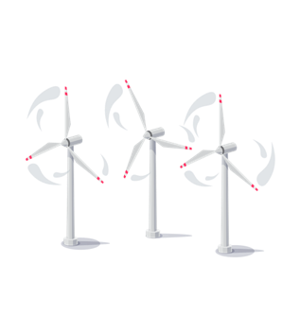











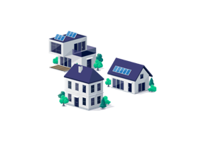





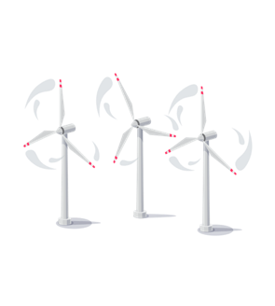

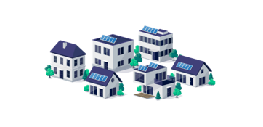

CHALLENGE
Electricity production and consumption must be the levelled every minute, and this is difficult when we use solar and wind energy
Flexibility is needed to facilitate the massive EU transitioning from fossil fueled to renewable production while in parallel balancing high security of energy supply and low transaction cost
IBM FLEX PLATFORM © Copyright IBM
2
Notes:
The Flex Platform can help to even out the imbalances that occur when we produce electricity from wind and sun. In Denmark, we have chosen to bet on wind and sun as a form of energy, but this also means that on the days when the wind does not blow and the sun does not shine, there is a trough in our energy production, and here we must have more smart solutions for to help us balance. And this is where the Flex Platform comes into the picture.

Slide 3
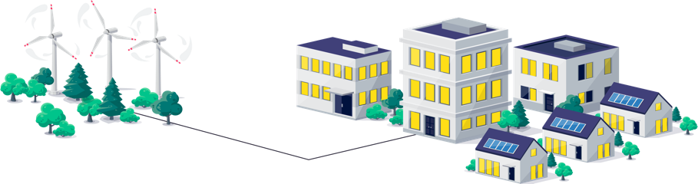
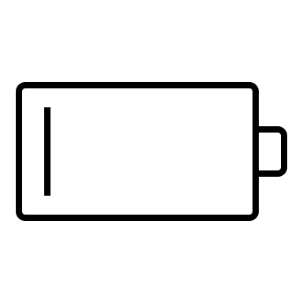





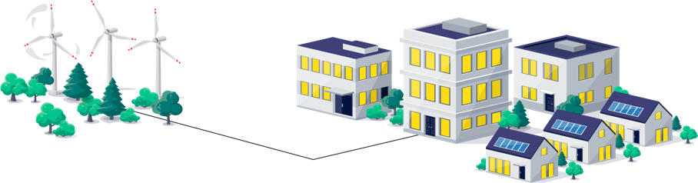
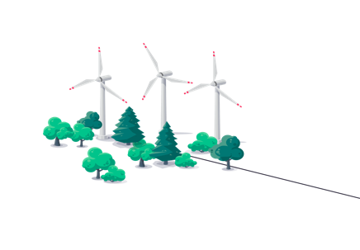




SOLUTION
When you provision demand-side flexibility, you help security of supply and you will be compensated as a reserve power plant.
MW
100%
1
CONSUMPTION EQUALS WIND POWER PRODUCTION
Production
Consumption
Time
NO WIND / SUN
MW
Production
0%
2
Standby reserve power plants receive payment for reservation and produce power when there is no wind
Consumption
Time
TOO MUCH WIND / SUN
MW
100%
3
Wind turbine owners receive payment for curtailing power production
Production
Consumption
Time
FLEX PLATFORM MAKES THE MATCH
The Flex Platform controls the demand for electricity to match the needs.
MW
60%
4
Production
Consumtion
Time
The payment is democratized back to the consumer.
IBM FLEX PLATFORM © Copyright IBM
3
Notes:
The Flex Platform can help to even out the imbalances that occur when we produce electricity from wind and sun. In Denmark, we have chosen to bet on wind and sun as a form of energy, but this also means that on the days when the wind does not blow and the sun does not shine, there is a trough in our energy production, and here we must have more smart solutions for to help us balance. And this is where the Flex Platform comes into the picture.
Simpelth explained, buildings are connected to the platform, which can communicate with e.g. building's ventilation system , cooling system or electric car charging stations . So, if the wind suddenly stops blowing, one of the wave valleys in power production occurs - more power is therefore needed than is produced. Today, a so-called renewable power plant will be switched on , which will produce the power that is missing in the system.
The Flex Platform offers a new and different option. With the Flex Platform, we can operate the power consumption on different systems (ventilation systems, heat pumps) so that it matches how much the wind blows or how much the sun shines. If it blows less, then we have the option in real time to turn it down, and if it blows more, then we have the option to turn it up. This is what the Flex Platform is used for - we manage the demand for electricity so that it matches the supply - i.e. the production. This is done in real time.
In this way, the Flex Platform ensures a more efficient utilization of the energy created from either wind or sun. Understood in the sense that when there is a trough in power production, Flex Platforme can e.g. turn down ventilation systems in a number of buildings and thus release some of the power created from either wind or sun.
Batteries: But the Flex Platform can actually do more than when it's too windy. It also ensures a more efficient use of the wind energy if it is too windy. Here, the buildings are converted into batteries.
We build a virtual battery of buildings. Instead of building battery parks, we can store our energy in heat or cold. If we have a heat pump in a house, we can heat our house up to 24 degrees when the wind blows a lot, and when it blows less and we need Power plants: that energy somewhere else, then we can let the temperature drop of 21-22 degrees and thus avoid using our heat pump for 30 min.
Today, it is regulating power plants that balance our power grid . And their role has not become less important as more and more of our electricity comes from, for example, wind turbines. Because if it suddenly blows less than you had predicted, you have to turn up one or more regulator power plants , so that the current that is in demand in the sockets is created. In other words, it is these regulating power plants that ensure that there is flexibility in our power grid . It's just a problem with these power plants - they run on fossil fuels and therefore emit co2. And they actually do that even when they are not producing electricity.
A regulated power plant is an engine. When you suddenly need it, you can't have to switch it on first - these regulating power stations are idle. You want to get rid of that. And here they would like to take advantage of consumption flexibility and create more dynamism in consumption patterns to balance the network instead. The Flex Platform therefore replaces these regulating power plants , which are being phased out.

Slide 4
THE MARKET FOR ELECTRICITY
The Electricity Markets
Future planning
Daily Operations
Settlement
TSO
BALANCING RESPONSIBLE
FINANCIAL
MARKET
SPOT
MARKET
INTRADAY
MARKET
BALANCING
MARKET
ANCILARY SERVICES
MARKET
Frequency Reserves
Automatic Reserves
Manual Reserves
SETTLEMENT
12:00 Day -1
-1 t
-45 min
0-2 min
5 min
15 min
DAY AHEAD & INTRADAY
OPERATIONS
The IBM Flex Platform is designed to deliver ancillary services for balancing the operations of the Europena power system.
This kind of demand-side flexibility will help substitute the fossil fueled spinning reserves, and make us less depended on Russian gas, as we reduce the CO₂ emmissions.
- PICASSO MEMBERS -
IBM FLEX PLATFORM © Copyright IBM
4

Slide 5
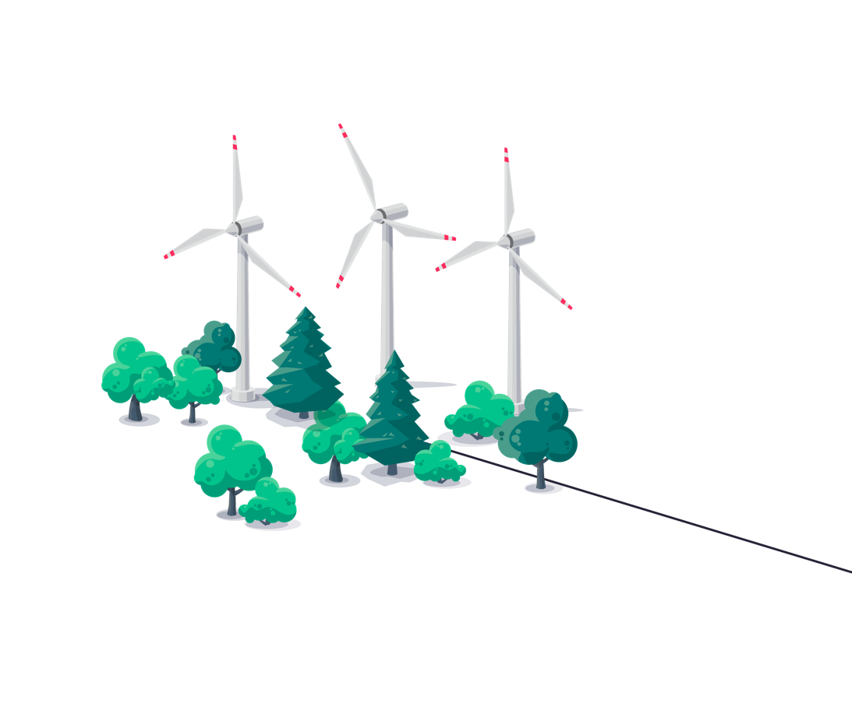
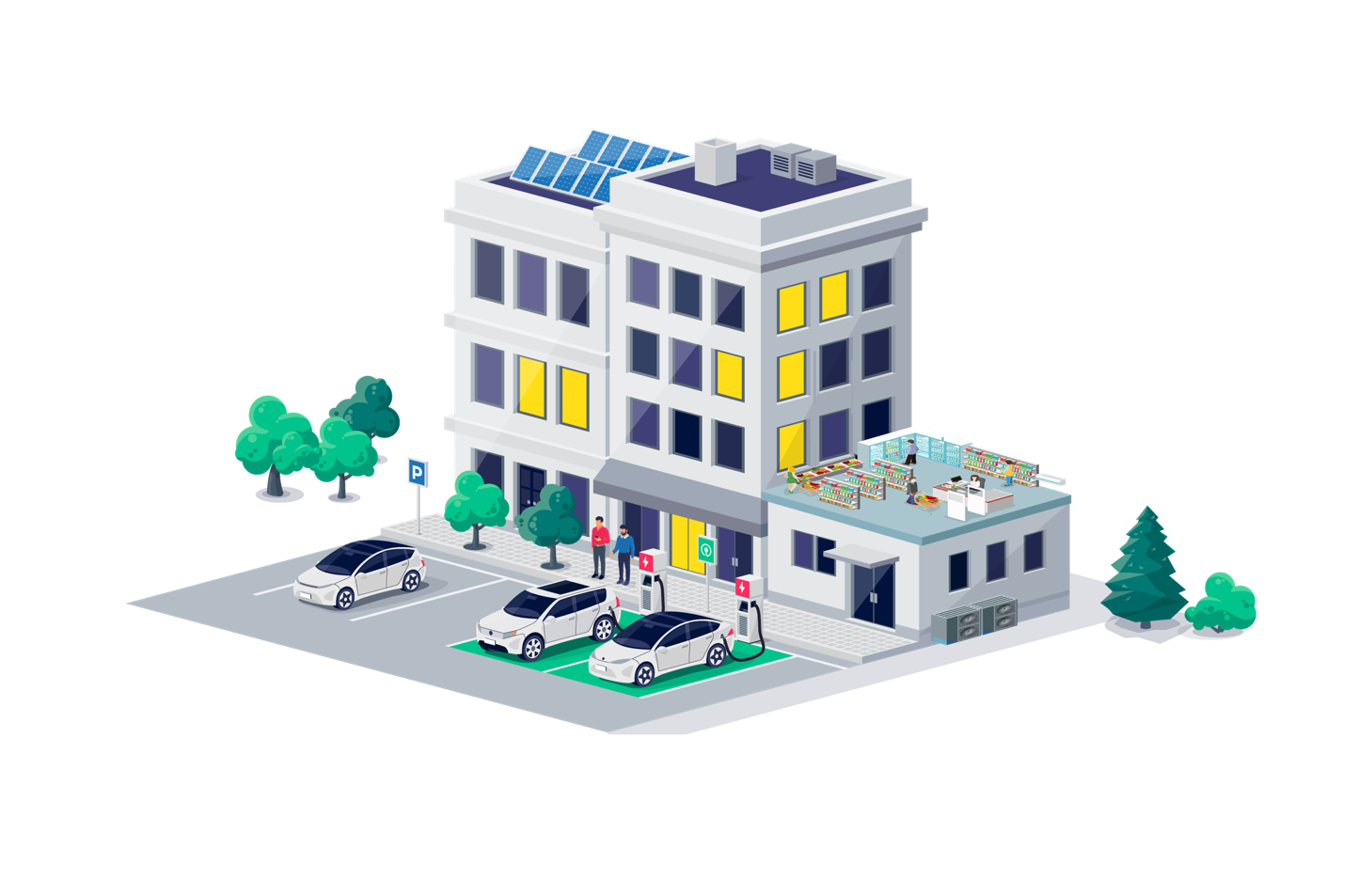




SOLUTION
We unlock a vast amount of demand-side flexibility that helps the security of supply and balance of the power system. The Flex Platform turn buildings and assets into virtual batteries.
  SOLAR POWER
  ~ 5 % extra earnings on power revenue
  VENTILATION & COMFORT COOLING
  ~ 40% flexibility potential
  ~ 20% savings on power costs
  HEAVY INDUSTRIAL PROCESSES
  ~ 25% flexibility potential
  ~ 5 % savings on power costs
  HEAT PUMPS
  ~40% flexibility potential
  ~ 10 % savings on power costs
€
EV CHARGING STATION
22 kW EV charging station
~ 10% savings on power costs
€
€
€
THE SPOT MARKET
ANCILLARY SERVICES
  Aggregator, which trades your flexibility to the system performance market
IBM FLEX PLATFORM © Copyright IBM

Slide 6
POSSIBILITY
You decide how you make your assets and electric cars available without compromising on comfort. The Flex Platform takes care of the rest.
You determine the Flex Profile for each asset...
Ventilation
Electric car charger
Reservation period (how long)
Heat pump
Frequency
(how often)
...and the Flex Platform optimizes the entire flexibility portfolio
Total power (installed)
Cooling
activation
potential
(how much)
activation
velocity
(how fast)
Battery
Pump
Activation period
(how long)
Rotor
IBM FLEX PLATFORM © Copyright IBM
6

Slide 7
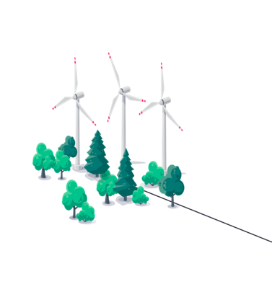




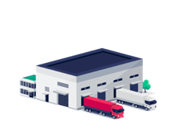
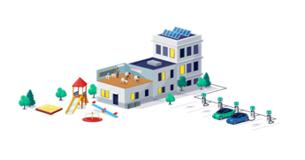
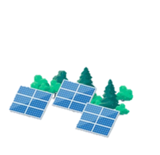





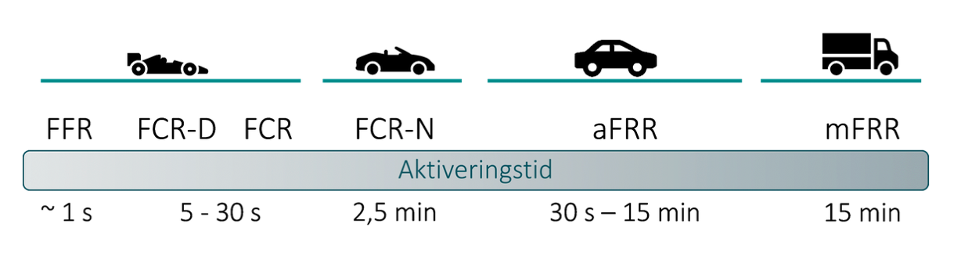

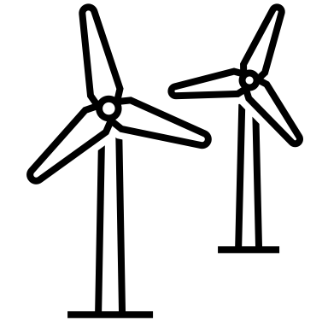

PLATFORM DESIGNED FOR SCALABLE DEMAND SIDE FLEXIBILITY
The Flex Platform is a secure cloud platform that activates energy consumers in the green transition. Through AI forecasting and aggregation, the platform provides demand-side energy flexibility from small and large assets to be traded in the energy market. The platform is scalable for most types of building management and control systems. The Flex Platform is characterized by being developed with safety as the cornerstone and with both operational stability and efficient integration technology as primary design principles. There is no need to install control boxes or sub-meters to become part of a new green and profitable ecosystem in the energy market.
SELECTED CLIENT CASES...
SCALABLE AND SECURE SOLUTION
The Flex Platform is a scalable and secure cloud solution for demand-side flexibility. The Flex Platform is developed based on IBM's high standards and strict requirements for IT security.
C&I HEAT PROCESSES
Client example: DOT. A/S (metal industry)
Asset type: Industrial melting pot
HVAC
Client example: City of Copenhagen
Asset types: Ventilation & Comfort Cooling
COOLING
Client example: Netto / Salling Group (super markets)
Asset type: Ventilation, Cooling, De-iceing
SOLAR POWER
Client example: Tryggevælde
Asset type: PV inverters
100% DIGITAL PLATFORM
The Flex Platform is designed to leverage existing control systems, avoiding the purchase of new physical control boxes or similar devices.
TELECOM
Client example: TDC NET
Asset type: Back-up power for switching centers
ELECTRICAL VEHICLES
Client example: CLEVER
Asset type: EV Charging stations
WELL-DEVELOPED TOOLBOX
Including tools and templates for technical and financial assessment and subsequent effective onboarding of flexibility providers.
AN AGGREGATOR SOLUTION DEVELOPED FOR ALL MARKETS IN EUROPE...
FAST ONBOARDING
1-2 days for secure integration with building management systems. 2-3 hours for digital onboarding of additional known asset types.
1-2 minutes for bulk onboarding.
IBM FLEX PLATFORM © Copyright IBM

Slide 8
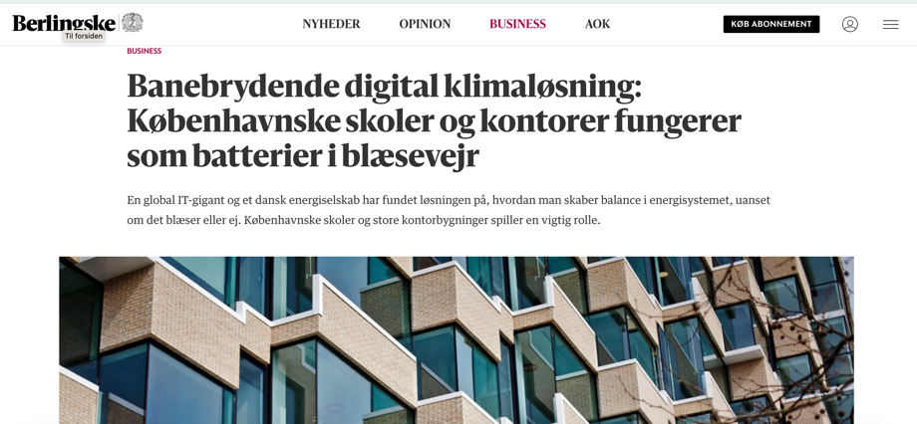
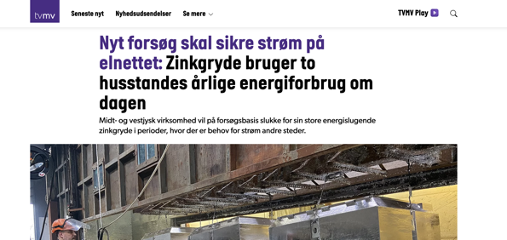



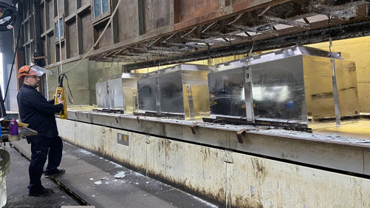


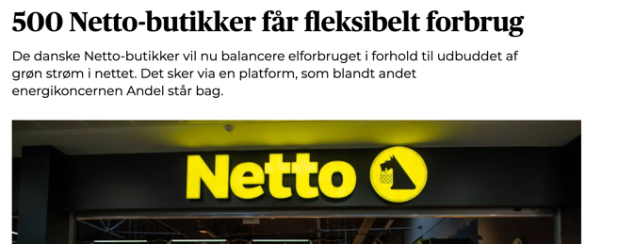


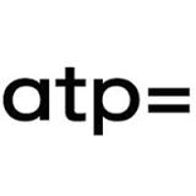
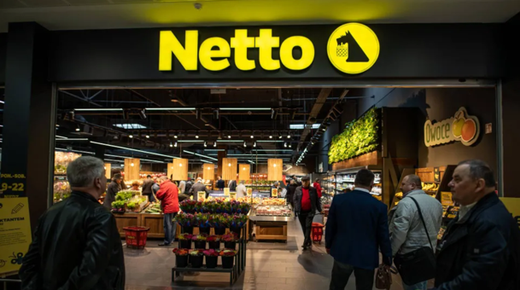
Together with front runners for the green agenda, the IBM’s Flex Platform is growing
Large power consumers in Denmark have started to trade their flexibility
  The City of Copenhagen (Schools, Administration, Sports Arenas)
  Netto/Salling Group (largest national supermarket chain)
  ATP (largest national pension fund)
  DOT Nordic (large metal company)
  EY Headquarter (commercial building)
  Tryggevælde Solar Park (large commercial solar park)
  Mat Dania (large metal company)
Together with our Danish strategic partner, Andel Energi, we are working on a pipeline of +200 MW, across supermarkets, logistic centers, water companies, cities, universities, pharmaceutical and the metal industry.
Assets in scope include EV charging stations, HVAC, process heating, process cooling, water treatment, deheat pumps and commercial batteries.
Currently, 50 supermarkets are being onboarded every week.
IBM FLEX PLATFORM © Copyright IBM
8

Slide 9
THANK YOU
FLEX PLATFORM
9

